Slide 1
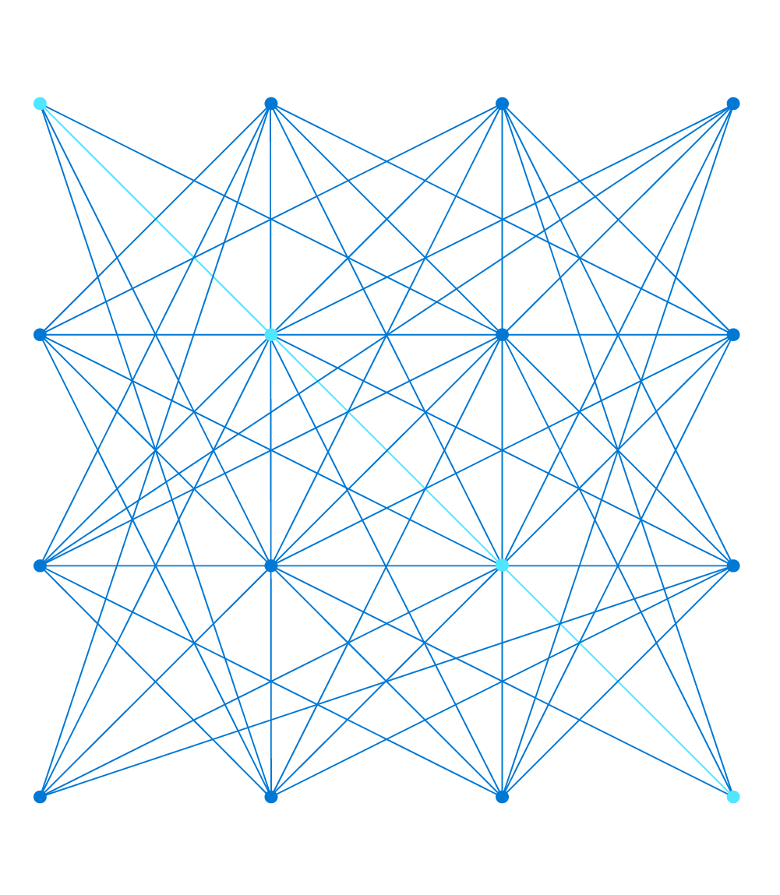
AZ-303: Microsoft Azure Architect Technologies

Slide 2
Module 7: Implement NoSQL Databases
Azure Storage Account Tables and CosmosDB APIs

Slide 3

Learning Objectives
You will learn the following:
Configure Storage Account Tables
Select Appropriate Cosmos DB APIs

Slide 4
Configure Storage Account Tables

Slide 5
Azure Table Storage (1 of 2)
Azure Table is a NoSQL datastore ideal for storing structured, non-relational data.
Common use of table storage
Storing TBs of structured data capable of serving web scale applications
Storing datasets that don't require complex joins, foreign keys, or stored procedures and can be denormalized for fast access
Quickly querying data using a clustered index
Accessing data using the OData protocol and LINQ queries with WCF Data Service .NET Libraries

Slide 6
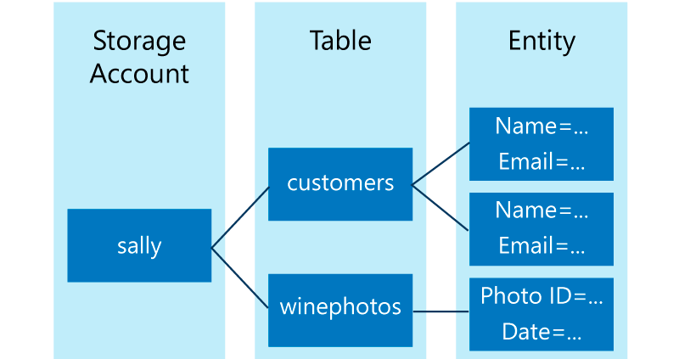
Azure Table Storage (2 of 2)
Table storage concepts
URL format:
http://<storage account>.table.core.windows.net/<table>
Accounts
Table
Entity
Properties

Slide 7
Table Service Data Model (1 of 2)
Storage account and table service https://myaccount.table.core.windows.net
Tables store data as collections of entities
Entities are similar to rows. An entity has a primary key and a set of properties.
A property is a name, typed-value pair, similar to a column.
An entity can have up to 255 properties, including 3 system properties
Table names must conform to the following rules
Table names must be unique within an account
Table names may contain only alphanumeric characters
Table names cannot begin with a numeric character
Table names are case-insensitive
Table names must be from 3 to 63 characters long
Some table names are reserved, including "tables"

Slide 8
Table Service Data Model (2 of 2)
System properties (automatically included for every entity in a table)
PartitionKey property: serves as the basis for table partitioning
RowKey property: a unique identifier for an entity within a given partition
Timestamp property: DateTime value that is maintained on the server side to record the time an entity was last modified

Slide 9

Select Appropriate Cosmos DB APIs

Slide 10
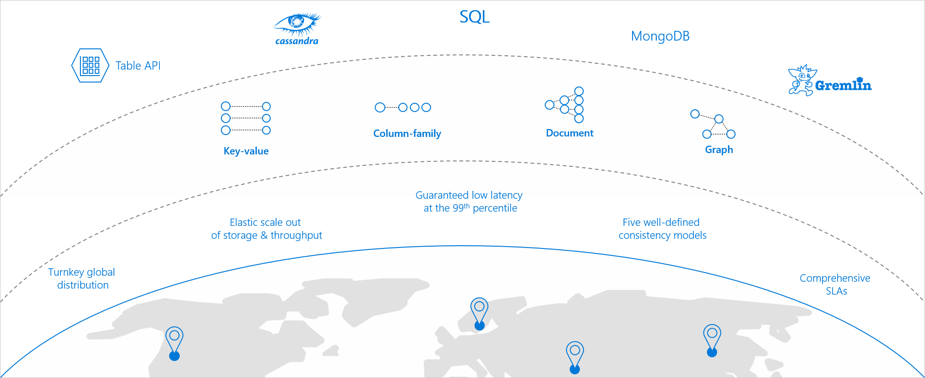
Overview of Azure Cosmos DB (1 of 2)
Azure Cosmos DB is a globally distributed and elastically scalable database.

Slide 11
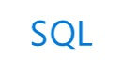




Overview of Azure Cosmos DB (2 of 2)
Cosmos DB supports a number of APIs
SQL
MongoDB
Cassandra
Table API
Gremlin

Slide 12
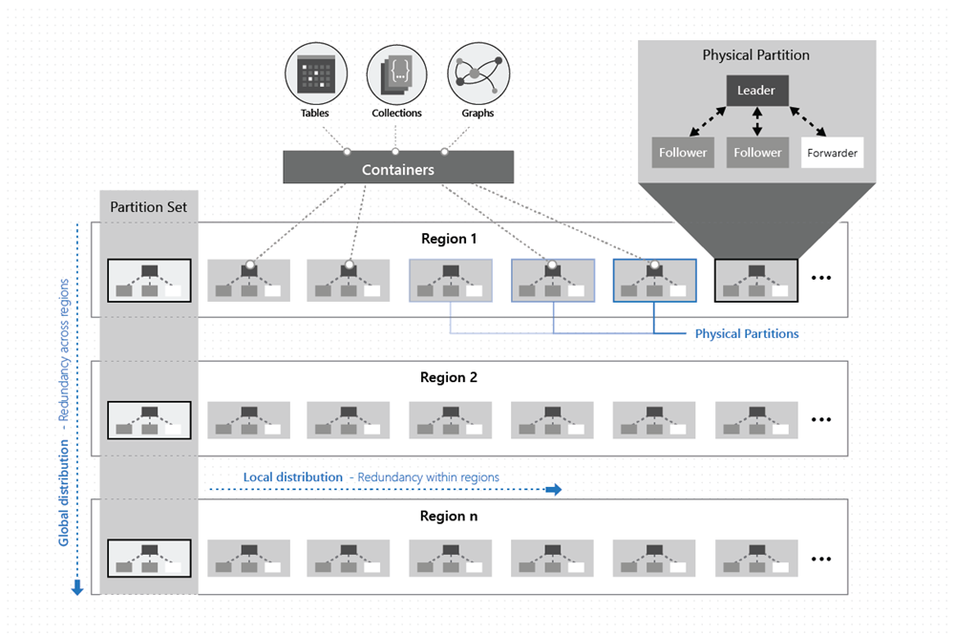
High Availability with Cosmos DB (1 of 3)

Slide 13
High Availability with Cosmos DB (2 of 3)
SLAs for availability
High availability with Cosmos DB in the event of regional outages
With Cosmos DB, before a write operation is acknowledged to the client, the data is durably committed by a quorum of replicas within the region that accepts the write operations
Multi-region accounts configured with multiple-write regions will be highly available for both writes and reads
Operation type | Single region | Multi-region (single region writes) | Multi-region (multi-region writes)
Writes | 99.99 | 99.99 | 99.999
Reads | 99.99 | 99.999 | 99.999

Slide 14
High Availability with Cosmos DB (3 of 3)
Multi-region accounts with a single-write region (write region outage):
During a write region outage, the Cosmos account automatically promotes a secondary region to be the new primary write region
Any write data that was not replicated when the region failed, is made available through the conflicts feed.
When the impacted write region recovers, it becomes automatically available as a read region
Multi-region accounts with a single-write region (read region outage):
During a read region outage, Cosmos accounts using any consistency level or strong consistency with three or more read regions will remain highly available for reads and writes
The impacted region is automatically disconnected and will be marked offline
If none of the regions in the preferred region list is available, calls automatically fall back to the current write region
Availability Zone support

Slide 15
Overview of Azure Cosmos DB Supported APIs (1 of 2)
MongoDB API
Acts as a massively scalable MongoDB service powered by the Azure Cosmos DB platform
Compatible with existing MongoDB libraries, drivers, tools, and applications
Table API
A key-value database service built to provide premium capabilities to existing Azure Table storage applications without making any app changes
Gremlin API
A fully managed, horizontally scalable graph database service
Easy-to-build and run applications that work with highly connected datasets supporting Open Graph APIs (based on the Apache TinkerPop specification, Apache Gremlin)
Notes:
Today, Azure Cosmos DB can be accessed by using five different APIs. The underlying data structure in Azure Cosmos DB is a data model based on atom record sequences that enabled Azure Cosmos DB to support multiple data models. Because of the flexible nature of atom record sequences, Azure Cosmos DB will be able to support many more models and APIs over time.
MongoDB API
The MongoDB API in Azure Cosmos DB acts as a massively scalable MongoDB service powered by the Azure Cosmos DB platform. It is compatible with existing MongoDB libraries, drivers, tools, and applications.
Table API
The Table API in Azure Cosmos DB is a key-value database service built to provide premium capabilities (for example, automatic indexing, guaranteed low latency, and global distribution) to existing Azure Table storage applications without making any app changes.
Gremlin API
The Gremlin API in Azure Cosmos DB is a fully managed, horizontally scalable graph database service that makes it easy to build and run applications that work with highly connected datasets supporting Open Graph APIs (based on the Apache TinkerPop specification, Apache Gremlin).

Slide 16
Overview of Azure Cosmos DB Supported APIs (2 of 2)
Cassandra API
Globally distributed Apache Cassandra service powered by the Azure Cosmos DB platform
Compatible with existing Apache Cassandra libraries, drivers, tools, and applications
SQL API
JavaScript and JavaScript Object Notation (JSON) native API based on the Azure Cosmos DB database engine
Provides query capabilities rooted in SQL
Queries for documents based on their identifiers or make deeper queries based on properties of the document, complex objects, or the existence of specific properties
Supports the execution of JavaScript logic within the database in the form of stored procedures, triggers, and user-defined functions
Notes:
Apache Cassandra API
The Cassandra API in Azure Cosmos DB is a globally distributed Apache Cassandra service powered by the Azure Cosmos DB platform. Compatible with existing Apache Cassandra libraries, drivers, tools, and applications.
SQL API
The SQL API in Azure Cosmos DB is a JavaScript and JavaScript Object Notation (JSON) native API based on the Azure Cosmos DB database engine. The SQL API also provides query capabilities rooted in the familiar SQL query language. By using SQL, you can query for documents based on their identifiers or make deeper queries based on properties of the document, complex objects, or even the existence of specific properties. The SQL API supports the execution of JavaScript logic within the database in the form of stored procedures, triggers, and user-defined functions.

Slide 17

Azure Cosmos DB Cassandra API
Benefits of using Apache Cassandra API for Azure Cosmos DB
No operations management
Open source standard
Performance management
Ability to use existing tools and code
Throughput and storage elasticity
Global distribution and availability
Choice of consistency
Enterprise grade
Event sourcing

Slide 18
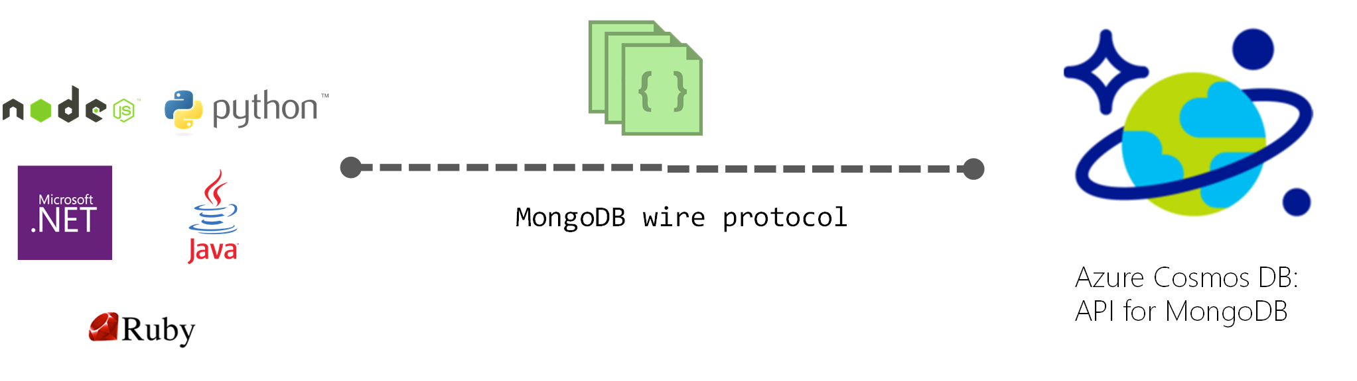
Azure Cosmos DB API for MongoDB
Wire protocol compatibility
Key benefits
The ability to for migrate applications to Cosmos DB while preserving significant portions of the existing application logic
Keeping applications portable and continuing to remain cloud vendor-agnostic
Financially backed SLAs for the common NoSQL APIs powered by Cosmos DB
Turnkey, global distribution with multi-master replication

Slide 19
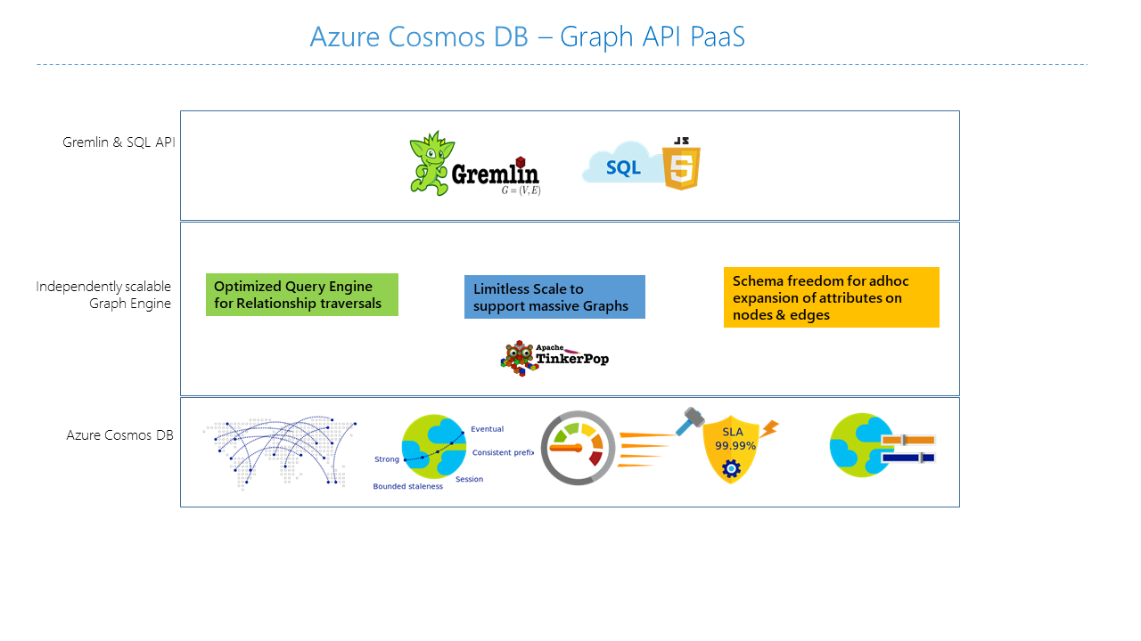

Azure Cosmos DB Gremlin API
Features of Azure Cosmos DB graph database
Elastically scalable throughput and storage
Multi-region replication
Fast queries and traversals with the most widely adopted graph query standard
Fully managed graph database
Automatic indexing
Tunable consistency levels
Graph databases
Property graph objects
Vertices
Edges
Properties

Slide 20
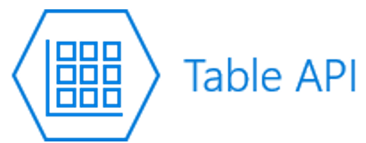
Azure Cosmos DB table API
Azure Cosmos DB provides the Table API for applications that are written for Azure Table storage and that need premium capabilities such as
Turnkey global distribution.
Dedicated throughput worldwide.
Single-digit millisecond latencies at the 99th percentile.
Guaranteed high availability.
Automatic secondary indexing.
If you currently use Azure Table Storage, you gain the following benefits by moving to the Azure Cosmos DB Table API
Latency
Throughput
Global distribution
Indexing
Query
Consistency
Pricing
SLAs

Slide 21

Module Review Questions

Slide 22
Online Role-based training resources: Microsoft Learn https://docs.microsoft.com/en-us/learn/

Slide 23
Thank you.

